Slide 1
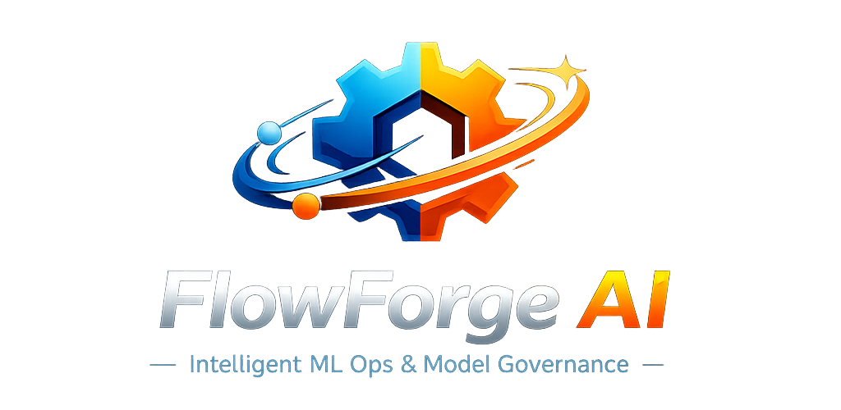
Presented By
Venkat Mamindla | Pooja Chandorkar | Vipin Panthri | Shashank Prakash

Slide 2
Problem Statement
The process we follow:
Manual EDA and feature engineering increase time-to-model.
Experiment tracking, model/data lineage and reproducibility remain fragmented.
Model governance and documentation are often post-hoc.
SME inputs are not systematically integrated into pipelines.
Monitoring and explainability setups require additional tooling.
Knowledge transfer across teams is slow and documentation-heavy.
Impact Today:
Longer model deployment cycles
Higher operational overhead
Governance and audit risks
Reduced experimentation velocity

Slide 3
Proposed Solution: FlowForge
FlowForge is an end-to-end agentic MLOps platform that automates model development, experimentation, governance, and monitoring using AI agents with a “human-in-the-loop” workflow.
Key Capabilities:
Automated EDA “Vibe Analysis”
AI-driven feature engineering & selection
AutoML model training & hyperparameter tuning
MLflow experiment tracking & registry
OOT validation & fairness checks
Monitoring & drift planning
Auto-generated model documentation
RAG-based lifecycle knowledge search

Slide 4
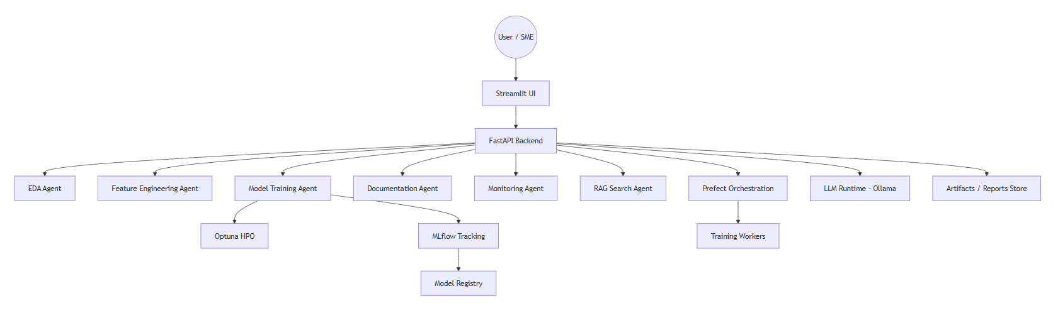
Architecture Diagram
Architectural Highlights:
User Feedback Based Development and Documentation | Agent orchestration via backend APIs
Full experiment lineage & artifact tracking | Agentic RAG based Knowledge Search

Slide 5
Business Benefits and ROI
Operational Benefits | Risk and Compliance Benefits | Cost and Productivity Gains
40–60% reduction in time-to-model development | Built-in model explainability | Reduced manual analytics effort
Faster experimentation & model iteration | Monitoring & drift detection planning | Lower documentation overhead
Auto-generated governance documentation | SME-validated feature engineering | Faster onboarding & knowledge transfer
Improved auditability & traceability | Centralized experiment lineage | Scalable multi-team usage

Slide 6
Questions?

